Slide 1
GCSE Computing Controlled Assessment
A453 PROGRAMMING PROJECT

Slide 2
Task 2
GITN Barcode

Slide 3
Objectives
The program will take an input and validate it’s length and that they are integers
The program will connect to a SQL database and run a query
The program will collect and display the results
The program will update the database with the customer’s order
The program will print a receipt
The program will cope with SQL errors

Slide 4
Pseudocode
User INPUT GTIN number
IF GTIN is numerical and 8 characters long:
Search Database for GTIN number
IF result found:
User INPUT quantity to order
IF quantity is more than 0 and less than or equal to stock available:
PRINT receipt with total cost (cost per item * quantity ordered)
Update Database with new stock (stock available – quantity ordered)
User INPUT choice to order more items
IF choice = yes:
Add to order list and return to GTIN INPUT
ELSE:
PRINT final receipt (order list) and end program
ELSE:
Return to Quantity INPUT
ELSE:
Return to GTIN INPUT
ELSE:
Return to GTIN INPUT

Slide 5
Test Plan
Input strings of incorrect length. If rejected, it passes
Input strings of letters. If rejected, it passes.
Input a valid string to search. If product found, it passes
Manually check that the program has displayed the correct stock level and information. If it does, it passes.
Order a quantity of the product. If the program updates the stock levels, it passes.
Complete a full order. If the program displays a receipt with the correct values, it passes
Provide the program with invalid values (such as ordering negative values). If the program rejects these, it passes.

Slide 6
Data Structure
Variable Name | Variable Description | Value
‘Con’ and ‘Cur’ | Connections to SQL database | N/A
‘var’ | User Input GTIN number | User Defined
‘results’ | Fetchall results from SQL query | N/A (list)
‘product’ | Equal to ‘results’, reformatted | Equal to ‘results’
‘sizeName’ and ‘sizeNameRaw’ | Variables used to format the name of the product | N/A (name of product selected)
‘QtyToOrder’ | User Input quantity ordered | User Defined
‘NewStockAvab’ | Variable used to update the SQL database with the new stock levels | [Stock Available]-[‘QtyToOrder’]
‘costOfOrder’ | Total cost of order | [Price of product]*[‘QtyToOrder’]
‘currentOrderAddRaw’, ‘currentOrderAdd’ and ‘currentOrder’ | Variables used to format and append the order to the entire list of order (to print receipt) | N/A

Slide 7
Development

Slide 8
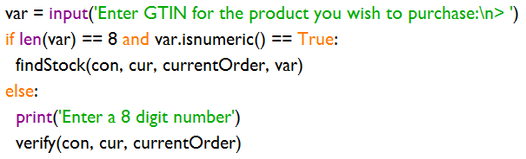

Objective 1 - The program will take an input and validate it’s length and that they are integers
Input the GTIN number
If the length of ‘var’ is 8 and it is numeric:
Call ‘findStock’ function
Else:
Return to input
If results are empty:
Return to input

Slide 9

Objective 2 - The program will connect to a SQL database and run a query
‘con’ = connect to the file ‘dbuse.db’
‘cur’ = prepare for query
Execute the following SQL query
‘results’ = SQL results

Slide 10
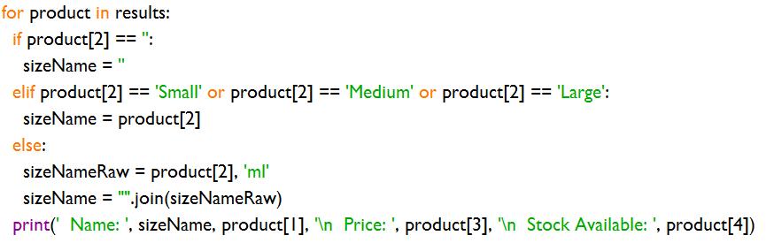
Objective 3 - The program will collect and display the results
If product has no quantities, display product[2]
If product has Small/medium/large quantity, append that to the front of product[2]
If product has numerical volume, append that, and ‘ml’ to the front of product[2]

Slide 11
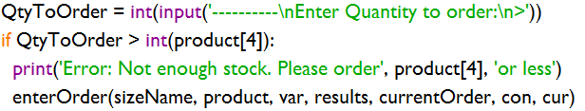
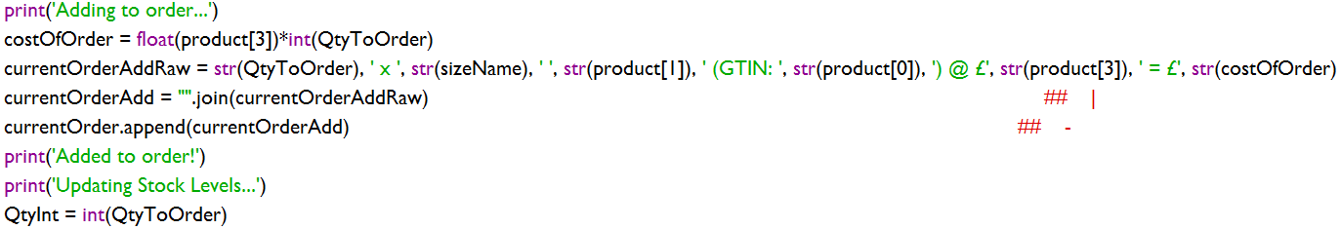
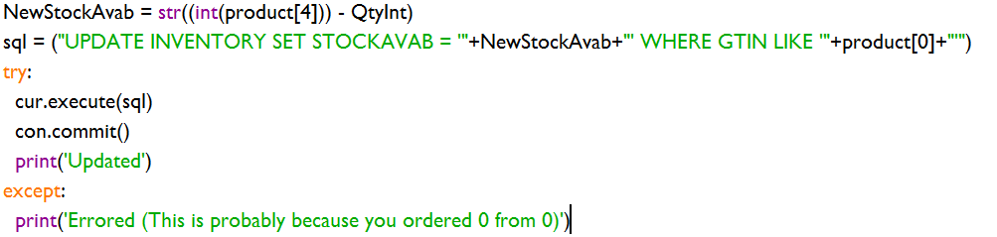
Objective 4 - The program will update the database with the customer’s order
User inputs the quantity.
If there is not enough stock, return to quantity
This section builds a human-readable receipt and adds it to the receipt array
The last line ensures the quantity is an integer
This section sends the update message to the SQL database
If the user orders 0 quantity from 0 stock level, the database will error

Slide 12
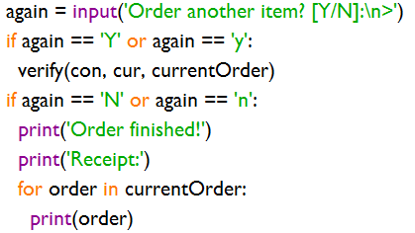
Objective 5 - The program will print a receipt
Ask the user if they want to order another item. If yes:
Return to input
Else:
Print the receipt created in the last objective

Slide 13

Objective 6 - The program will cope with SQL errors
This section prevents the user ordering a negative number, and thus adding to the stock level
If quantity is less than 1:
Return to quantity input

Slide 14
Testing

Slide 15
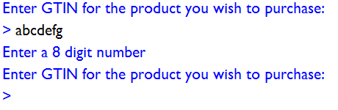
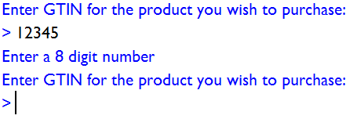

Objective 1 - The program will take an input and validate it’s length and that they are integers
Enter as text string. If rejected, it passes
Enter a integer shorter than 5 characters. If rejected , it passes
Enter a valid number (8 char integer). If accepted, it passes
Passed

Slide 16
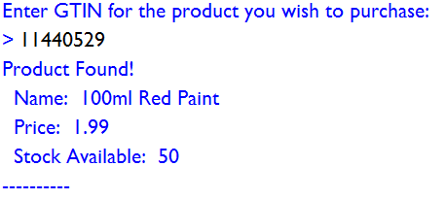


Objective 2 - The program will connect to a SQL database and run a query
Enter a valid GTIN number in the database. If the information is found, it passes
Enter a valid GTIN number not in the database. If no product is found, it passes.
Passed

Slide 17
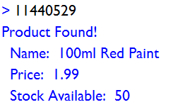

Objective 3 - The program will collect and display the results
Enter a valid GTIN number in the database. If the correct information is shown, it passes.
Passed

Slide 18
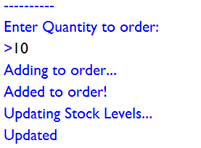

Objective 4 - The program will update the database with the customer’s order
Order a quantity of a product in the database. If the database is then updated with the correct stock, it passes.
Passed

Slide 19

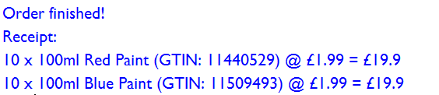
Objective 5 - The program will print a receipt
Order a quantity of a product in the database. If the correct information is printed in the receipt, it passes.
Order 2 or more products in the database. If the correct information for both is printed in the receipt, it passes.
Passed

Slide 20
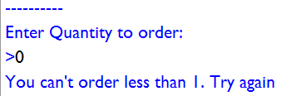
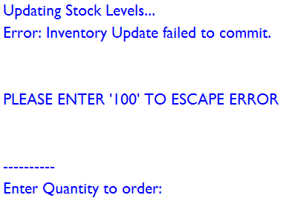
Objective 6 - The program will cope with SQL errors
Enter an 1 or 0 in quantity. If the program copes with the SQL maths error, it passes
Note: If a number larger than the stock available is sent, and the user attempts to enter a correct value, the program will enter an SQL error loop. The easiest fix for this is for the user to enter 100, and the program detects and discards this, exiting the SQL error loop. The user can then continue.
Passed

Slide 21
Final Program

Slide 22
Raw Data
__authors__ = ['Thomas Bass']
## Candidate Number 4869 | Centre Number 52423
## TASK 2 ##
import sqlite3 as lite
import random
import math
currentOrder = []
con = lite.connect('dbuse.db') ## connects to Database
cur = con.cursor()
def verify(con, cur, currentOrder):
var = input('Enter GTIN for the product you wish to purchase:\n> ')
if len(var) == 8 and var.isnumeric() == True:
findStock(con, cur, currentOrder, var)
else:
print('Enter a 8 digit number')
verify(con, cur, currentOrder)
def findStock(con, cur, currentOrder, var):
cur.execute('SELECT * FROM Inventory WHERE GTIN = ?', (var,)) ## excutes
results = cur.fetchall() ## collects results from SQL
con.commit()
if results == []:
print('No product found. Please try again')
verify(con, cur, currentOrder)
print('Product Found!')
for product in results:
if product[2] == '':
sizeName = ''
elif product[2] == 'Small' or product[2] == 'Medium' or product[2] == 'Large':
sizeName = product[2]
else:
sizeNameRaw = product[2], 'ml'
sizeName = "".join(sizeNameRaw)
print(' Name: ', sizeName, product[1], '\n Price: ', product[3], '\n Stock Available: ', product[4])
enterOrder(sizeName, product, var, results, currentOrder, cur, con)
def enterOrder(sizeName, product, var, results, currentOrder, cur, con):
QtyToOrder = input('----------\nEnter Quantity to order:\n>')
if QtyToOrder.isnumeric() == False:
print('Enter a valid Number')
enterOrder(sizeName, product, var, results, currentOrder, cur, con)
elif int(QtyToOrder) > int(product[4]):
print('Error: Not enough stock. Please order', product[4], 'or less')
enterOrder(sizeName, product, var, results, currentOrder, con, cur) ##Recalls the last func
elif int(QtyToOrder) < 1:
print('You can\'t order less than 1. Try again')
enterOrder(sizeName, product, var, results, currentOrder, con, cur)
else:
print('Adding to order...')
NewStockAvab = 0
costOfOrder = float(product[3])*int(QtyToOrder)
currentOrderAddRaw = str(QtyToOrder), ' x ', str(sizeName), ' ', str(product[1]), ' (GTIN: ', str(product[0]), ') @ £', str(product[3]), ' = £', str(costOfOrder) ## -Builds the reciept text
currentOrderAdd = "".join(currentOrderAddRaw) ## | ## -
print('Added to order!')
print('Updating Stock Levels...')
QtyInt = int(QtyToOrder)
NewStockAvab = str((int(product[4])) - QtyInt)
sql = ("UPDATE INVENTORY SET STOCKAVAB = '"+NewStockAvab+"' WHERE GTIN LIKE '"+product[0]+"'")
try:
cur.execute(sql)
con.commit()
print('Updated')
except:
print('Error: Inventory Update failed to commit.')
currentOrder.append(currentOrderAdd+' [CANCELLED]')
print('\n\nPLEASE ENTER \'100\' TO ESCAPE ERROR\n\n')
enterOrder(sizeName, product, var, results, currentOrder, cur, con)
currentOrder.append(currentOrderAdd) ## Appends to order only after successful sql commit
again = input('Order another item? [Y/N]:\n>')
if again == 'Y' or again == 'y':
verify(con, cur, currentOrder)
if again == 'N' or again == 'n':
print('Order finished!')
print('Receipt:')
for order in currentOrder:
print(order)
def ask(cur, con, currentOrder):
askQuery = input('Press [s] to search for a product\'s GTIN number:\n> ')
if askQuery == 's' or askQuery == 'S':
verify(con, cur, currentOrder)
else:
print('Invalid Choice')
ask(cur, con, currentOrder)
ask(cur, con, currentOrder) ## Calls first func

Slide 23
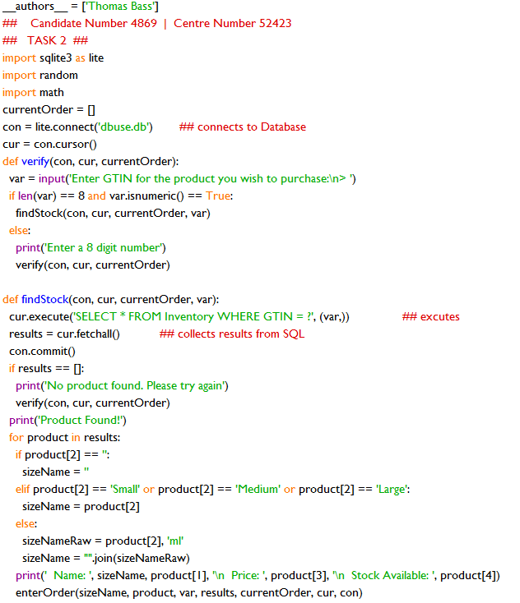
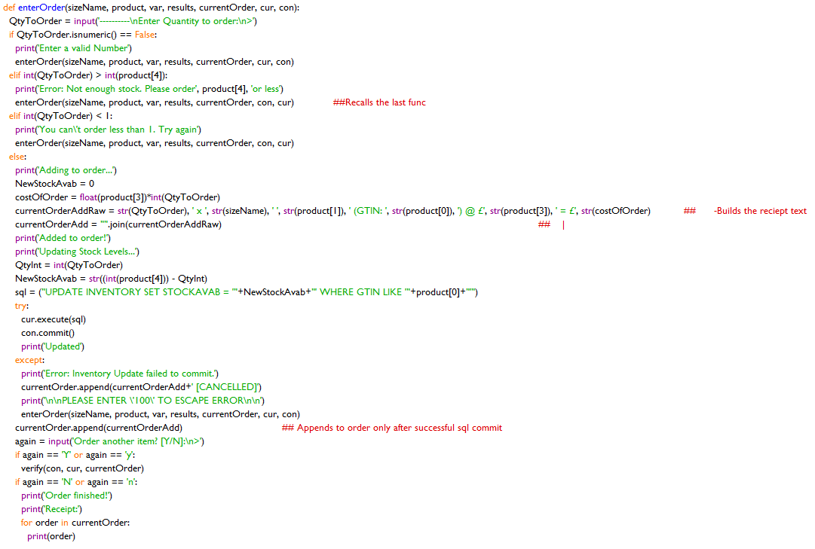
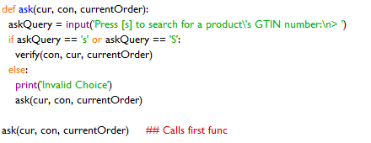
Formatted Photo

